Slide 1
Milestone 3
CST-135 Matt Sievers

Slide 2
Project URLs
Code – https://github.com/Malleas/CST-135/tree/master/src/Milestone
Storyboard - https://www.meistertask.com/projects/jzoif109jd/join/
Video - https://www.loom.com/share/13777cf75b174a8f972aea9e4d94955d

Slide 3
Planning
Research Switch/Case logic as it seems to be the best way to use a console input app.
Research Scanner and how to take multiple inputs.
Create methods to update contacts as well as create the base menu. updateContacts() currently lives within the console app, this may change based on requirements going forward.
Update helper classes in AddressBook class to accommodate for the new requirements for the console app.
Implement a “go back” option to some of the menus and do it implicitly like on the creation of a new contact, should re route back to main menu.
Test functionality of app.
Wrap main switch/case in a while(true) loop to keep the loop open until user Exits. All addresses should be held in memory using the AddressBook class and it’s helpers used to access it.

Slide 4
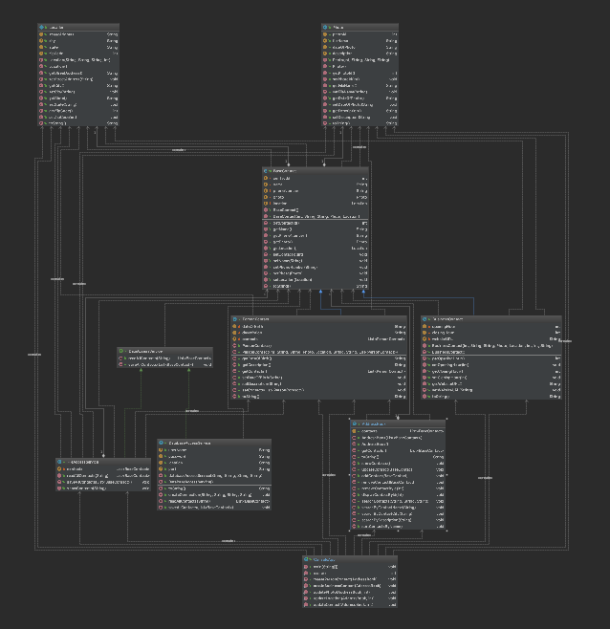
UML Updates

Slide 5
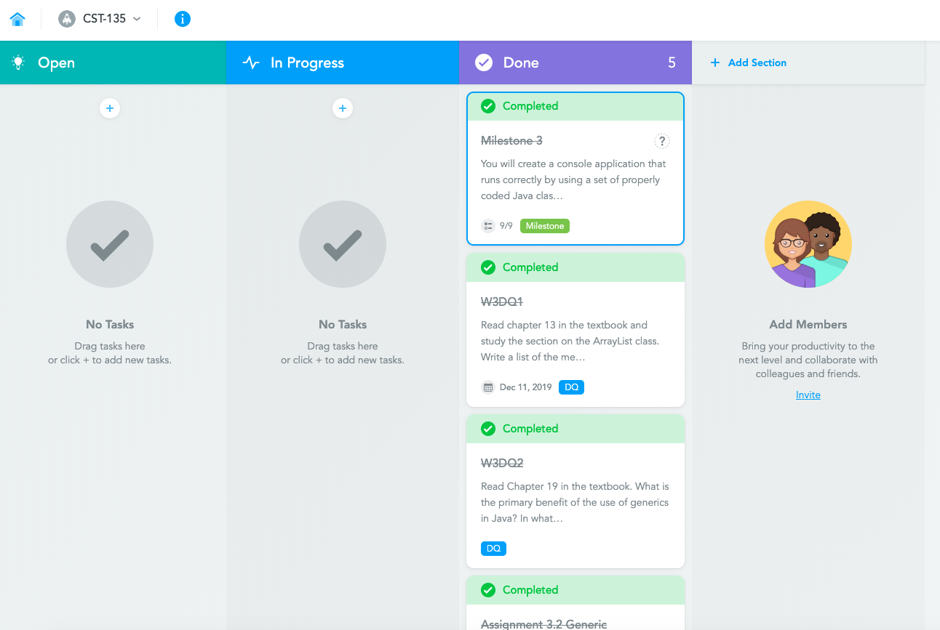
StoryBoard

Slide 6
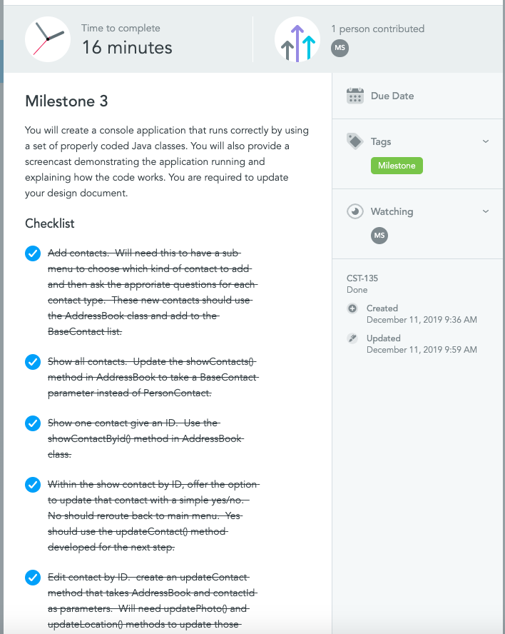
Milestone Story

